Slide 1
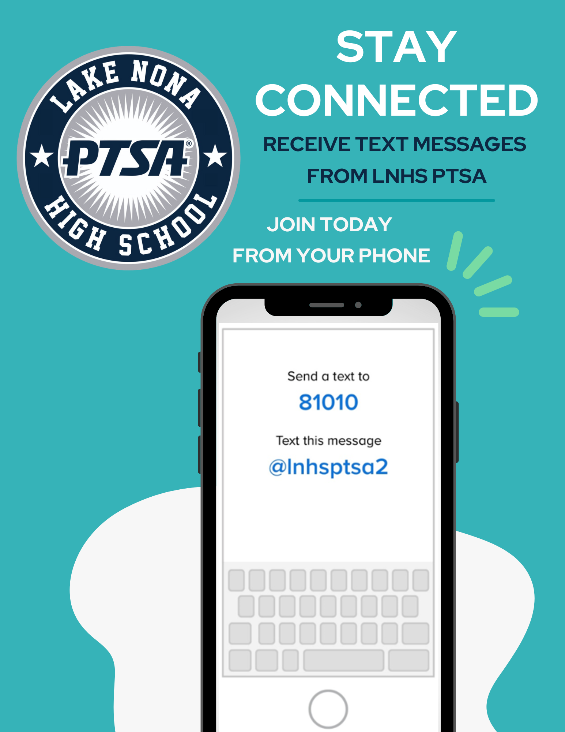


WELCOME
LNHS PTSA
GENERAL MEETING
WEDNESDAY
SEPTEMBER 11, 2024
6:30PM
MEDIA CENTER
www.LNHSPTSA.com

Slide 2
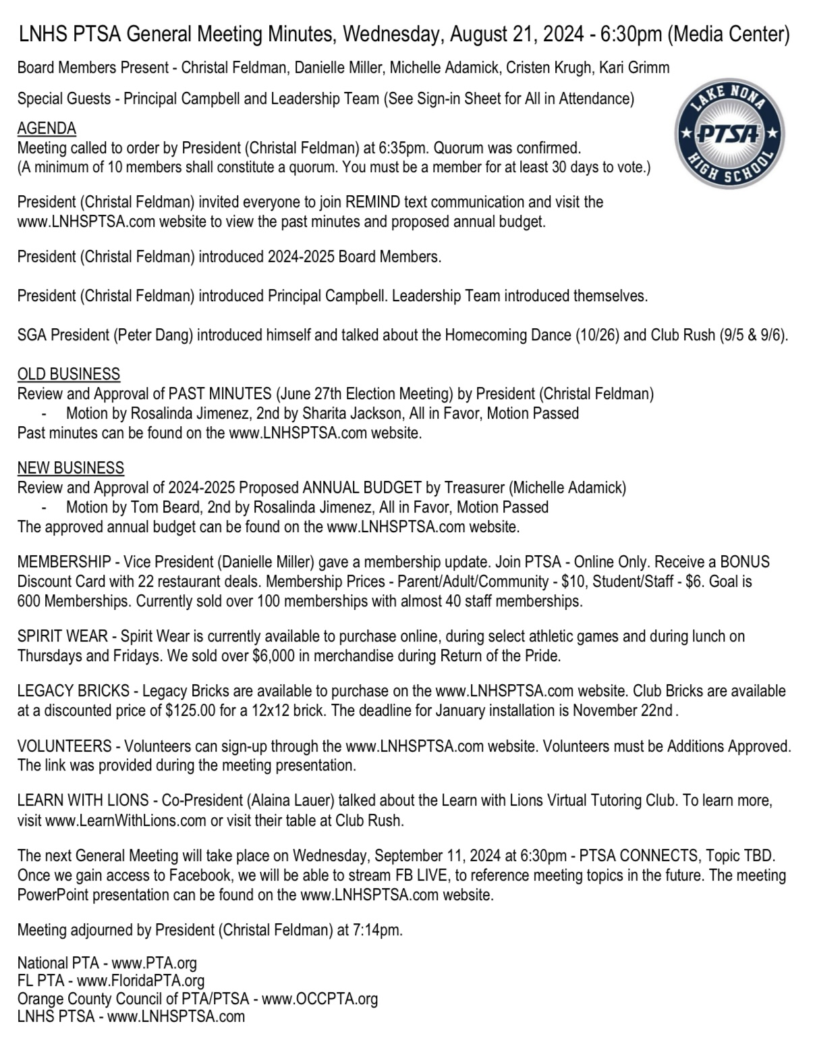

PAST MINUTES
AUGUST 21, 2024
FOR APPROVAL
2024 - 2025 Annual Budget Review

Slide 3
SUMMARY
INCOME
Mostly Spirit Wear Income - Over $6,500
(166) Memberships - $826
Donations - $230
Legacy Bricks - $325
EXPENSES
Outstanding 2023-2024 Checks - $700
Website Fees/Domain Name - $142.17
Liability Insurance - $135
OCCPTA Dues & Donation - $100
(166) Memberships x $3.50 = $581 to FL PTA
Discount Cards - $375
Sam’s Membership - $110
(Keep $1,000 Balance in Bank Account)
AUGUST
FINANCIAL
REPORT
2023-2024 Audit
Submitted on August 31st
Starting Balance - $2,062.71
Ending Balance - $9,450.95

Slide 4



Help Us Meet Our Goal of 600 Memberships!
Parents - 77, Staff - 46, Students - 45, Community - 6
174 Memberships

Slide 5


Slide 6



Slide 7
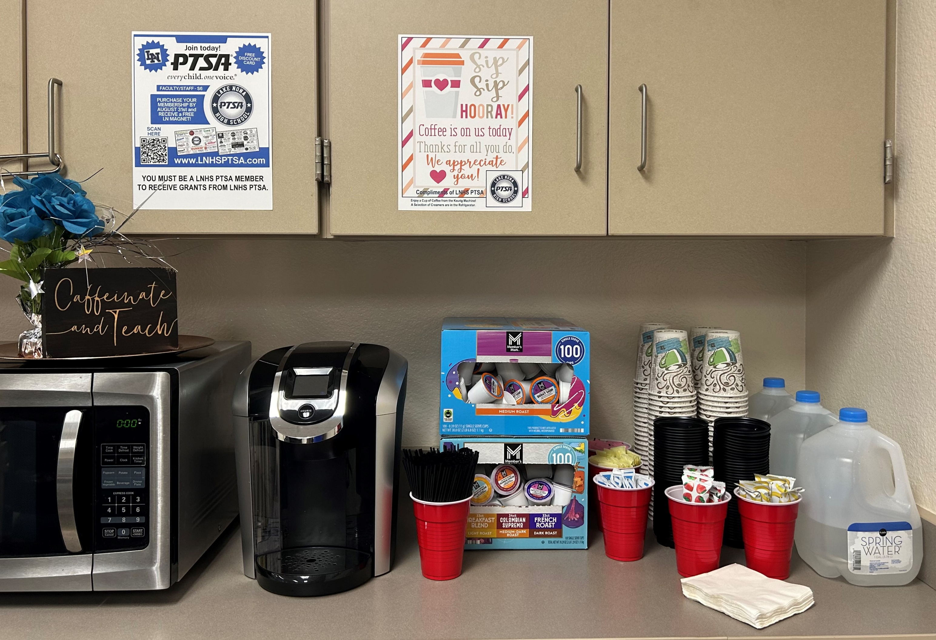
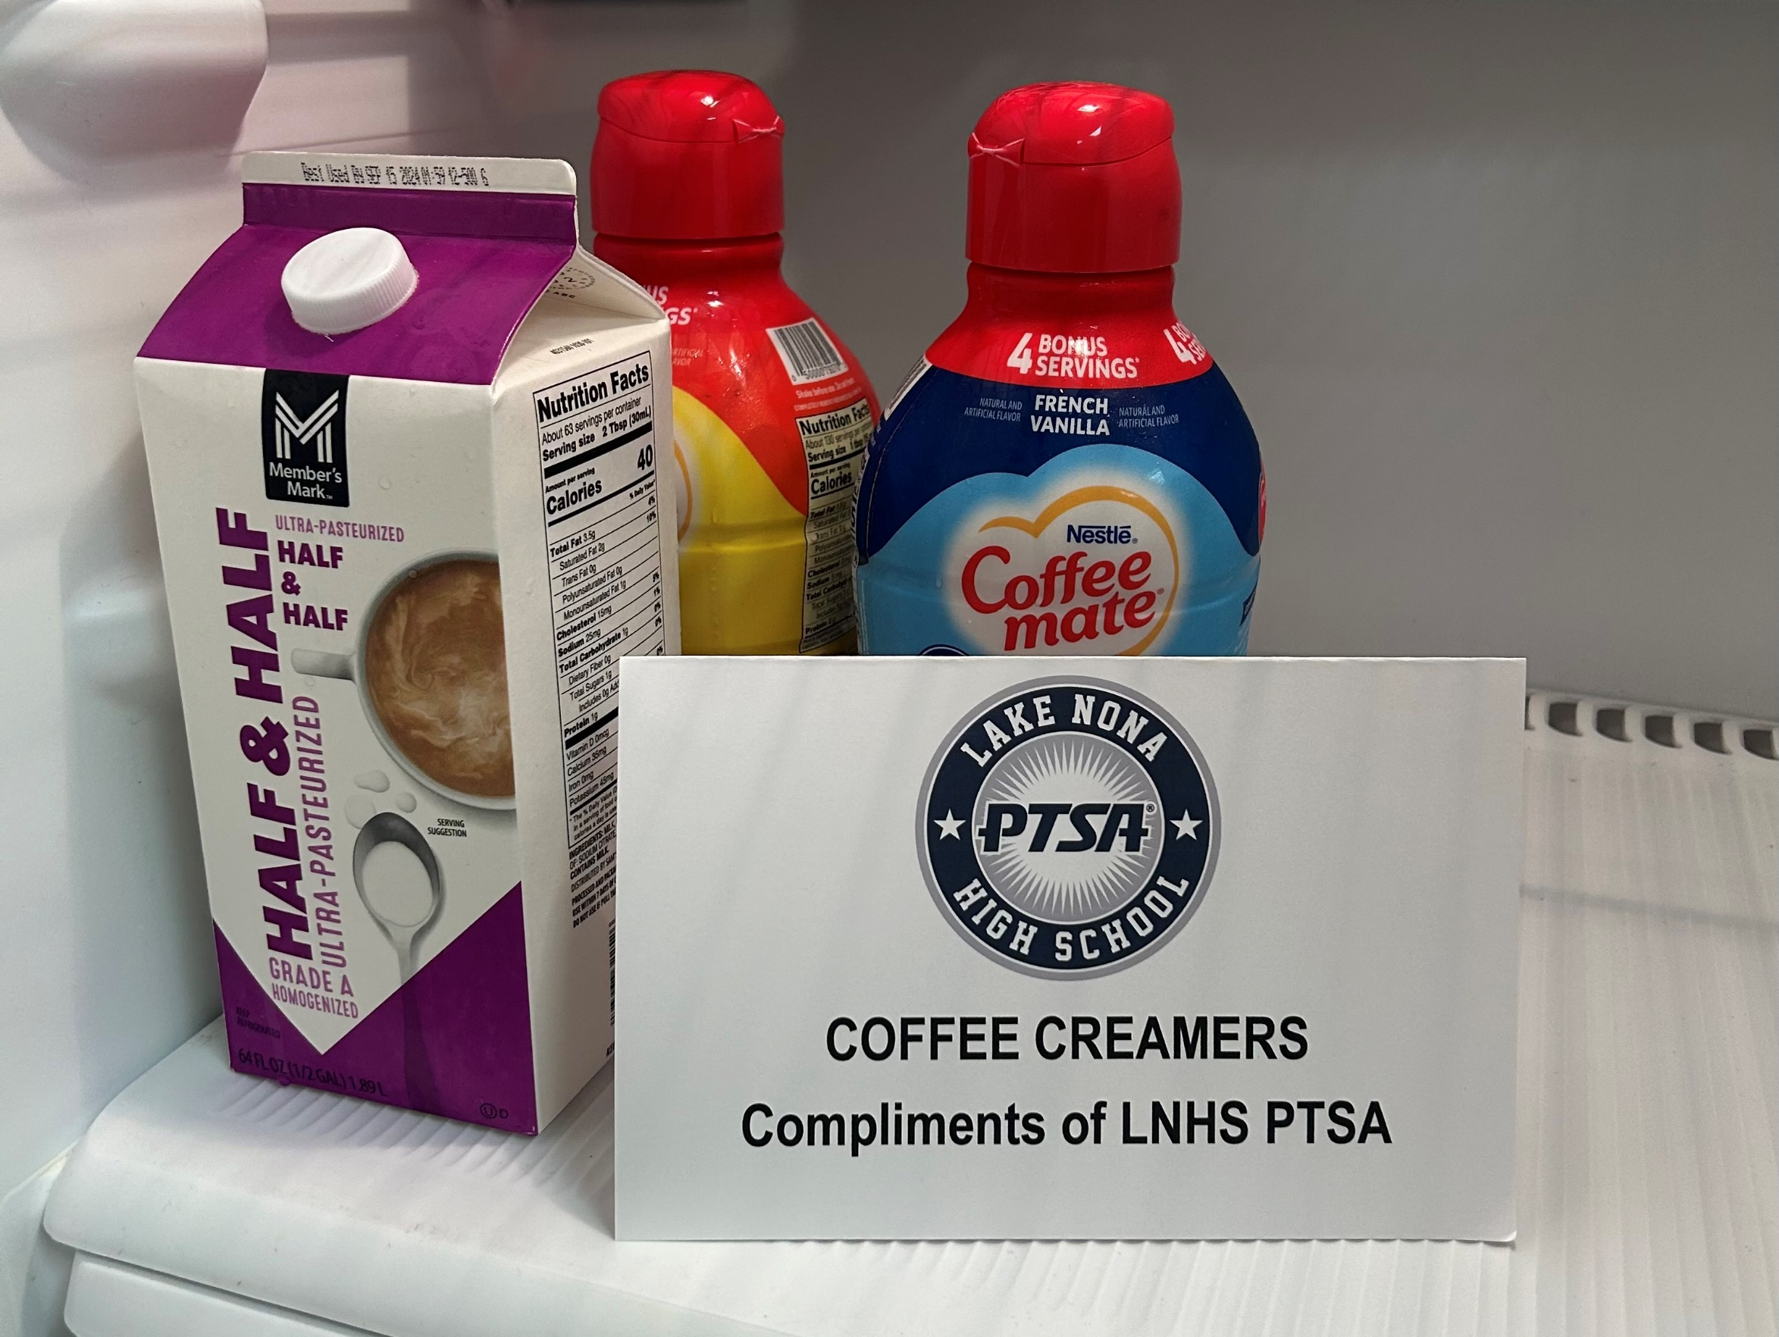
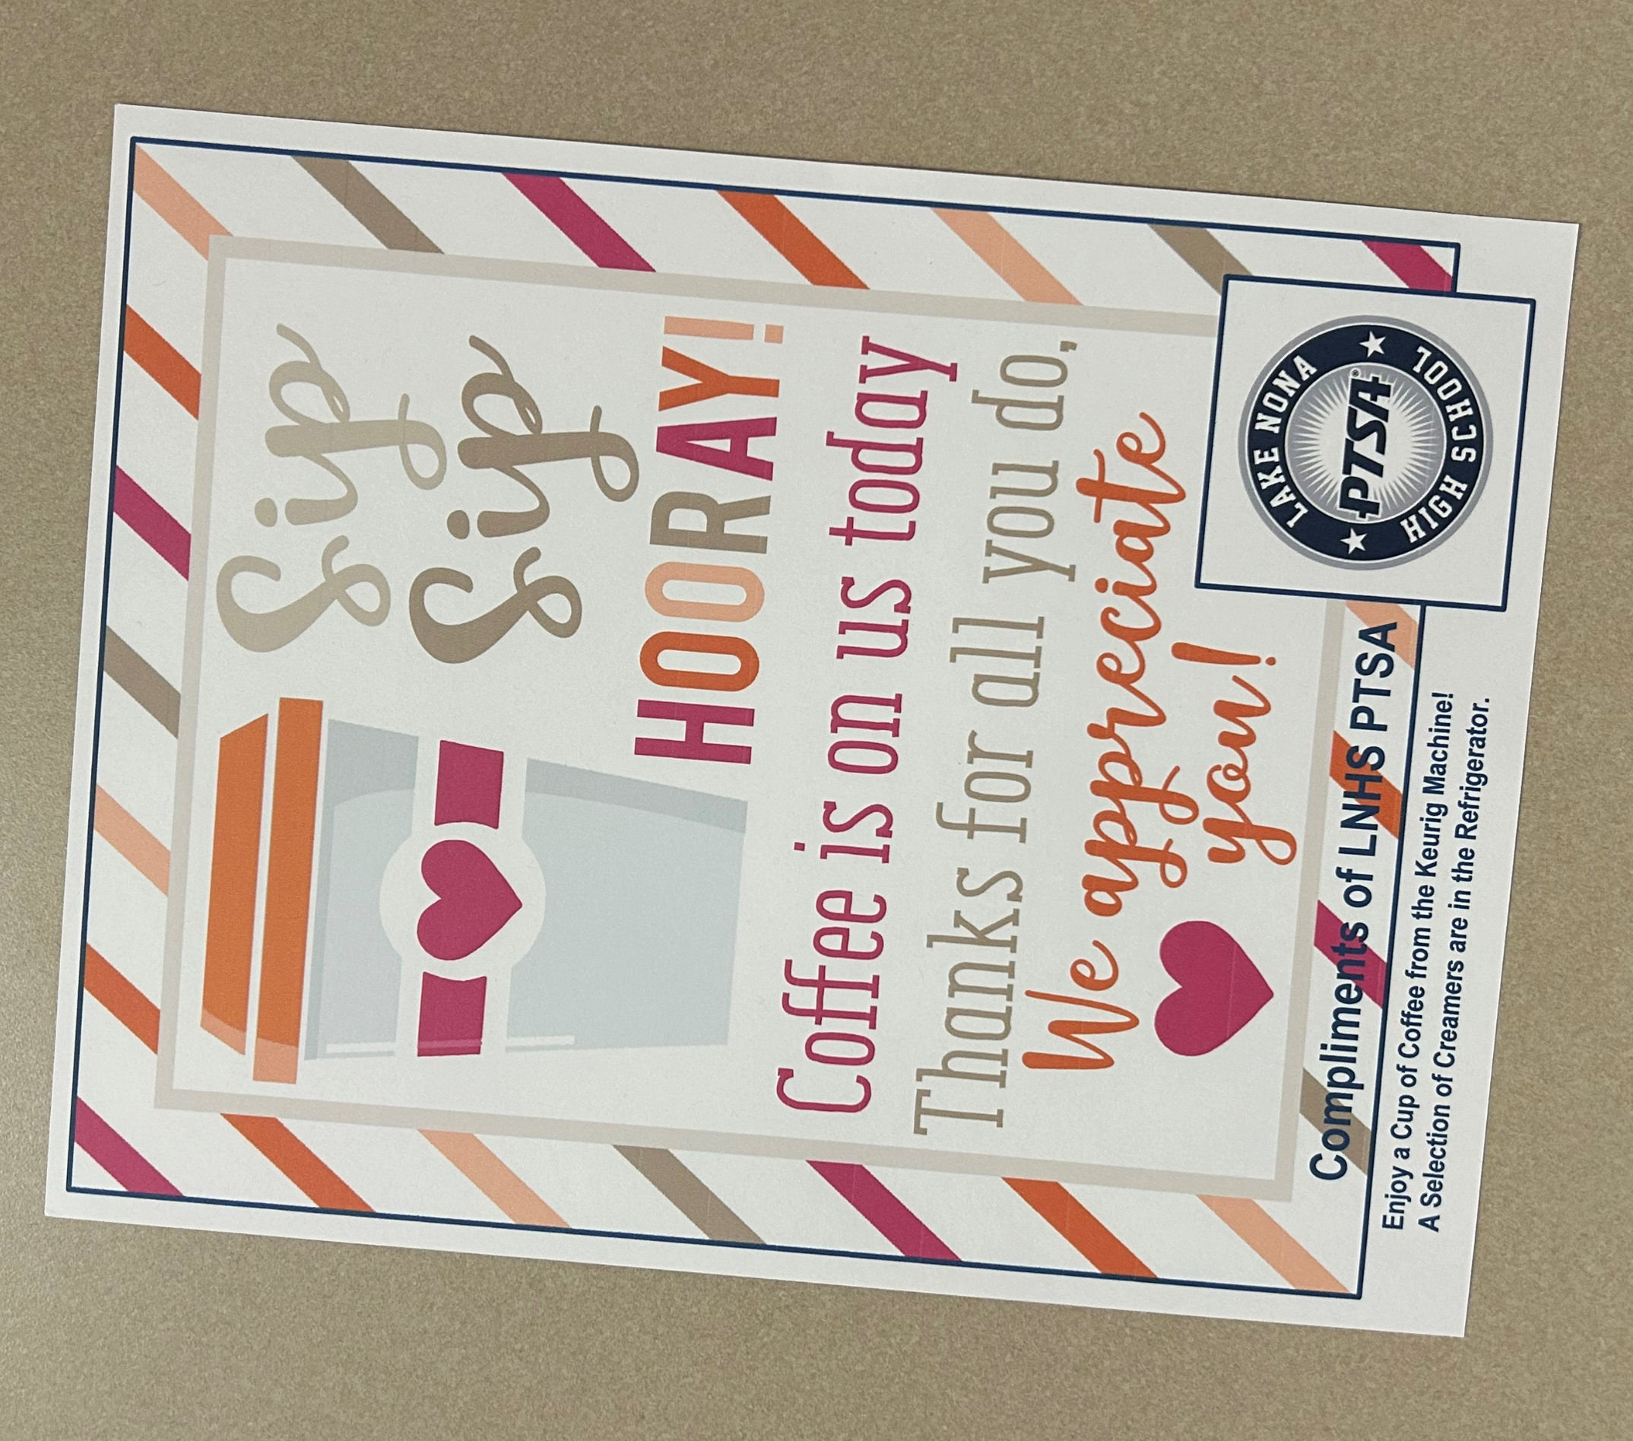
Coffee Station
STAFF APPRECIATION
Upcoming Events

Slide 8


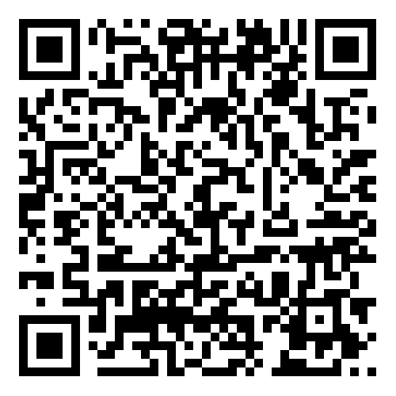

EMAIL - LNHSPTSA@gmail.com
WEBSITE - www.LNHSPTSA.com

Slide 9


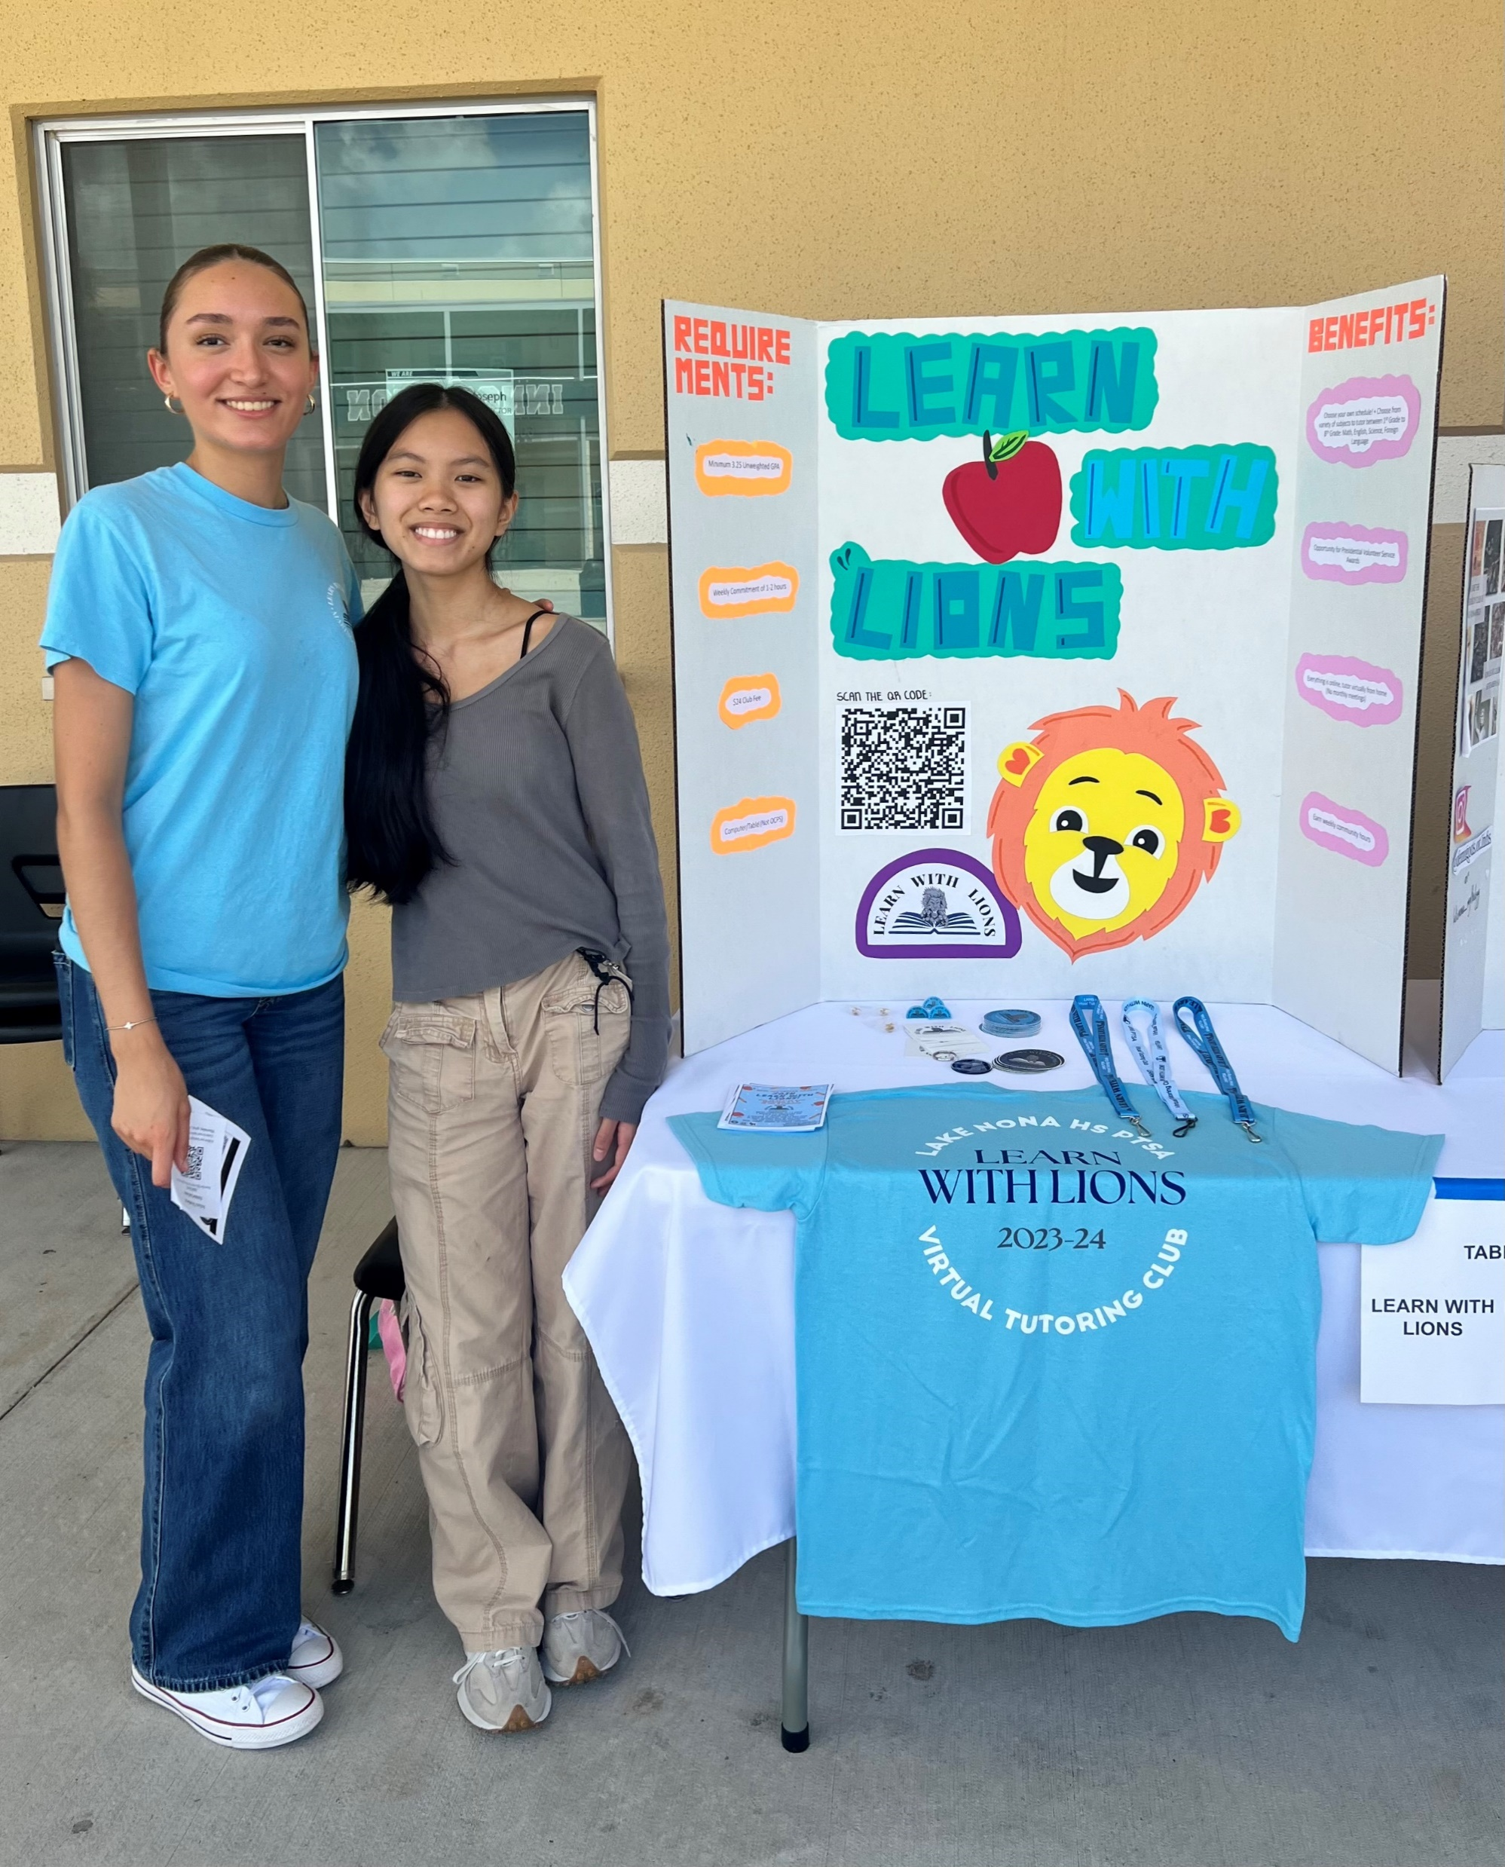
CLUB RUSH

Slide 10

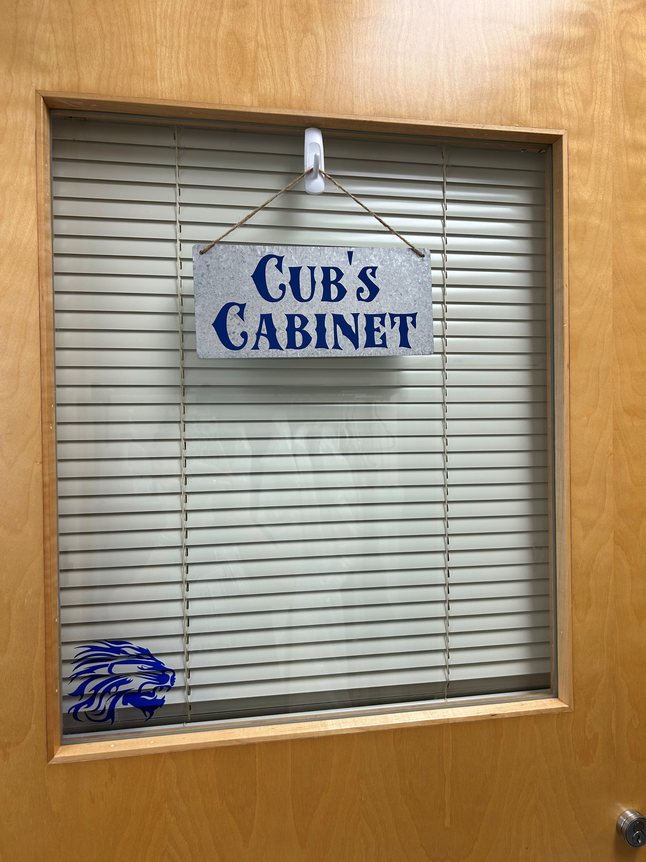
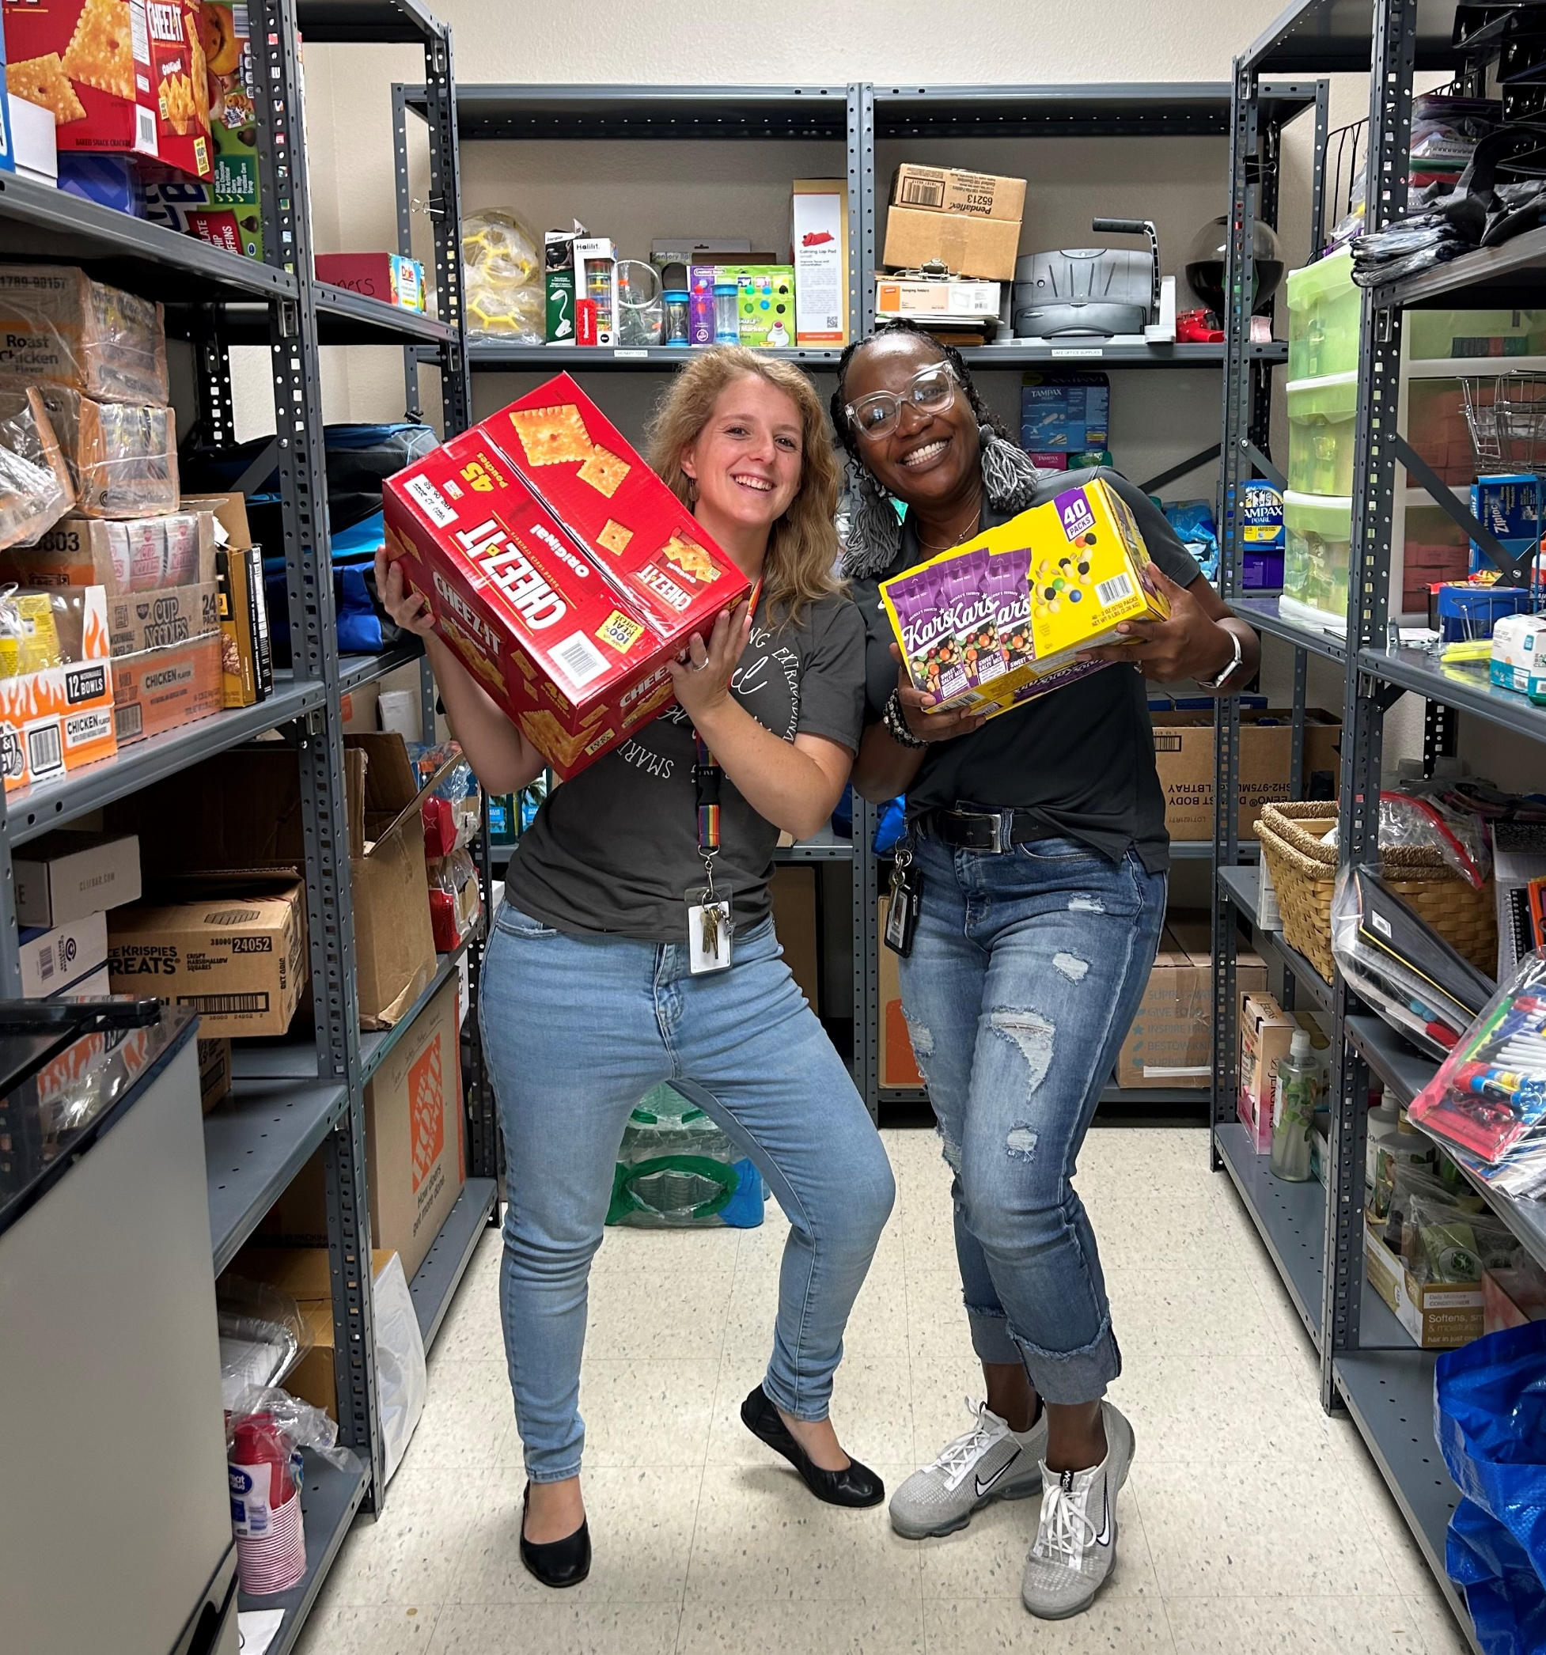
THANK
YOU!

